Slide 1
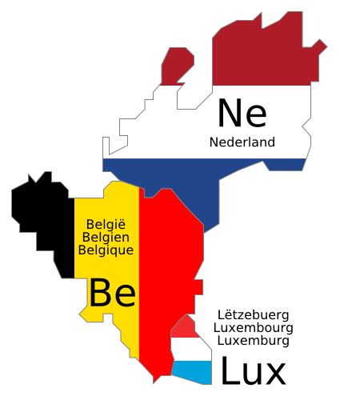
Health Care in the Benelux Services Available to Older Adults Ways to Age Well

Slide 2
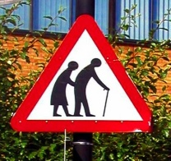

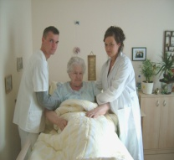

Agenda
1. Tasks
2. Netherlands
3. Belgium
4. Luxembourg

Slide 3
Agenda
1. Tasks
2. Netherlands
3. Belgium
4. Luxembourg

Slide 4
1.1 Tasks
1
benefits associated with federal, state, and local government and agencies,
including an understanding of the health services available to older adults
(and how to access them)
data and statistics on employee caregivers in Benelux
information on health issues of caregivers
aging population data with links to state, federal or university websites
free, downloadable e-books or studies on the issues of aging and/or
caregiving

Slide 5
1.1 Tasks
1
local and regional caregiver support groups
local and regional services related to elder care
links to international organizations, such as the Alzheimer's Association
links to elder care and caregiving information/services through EU
other materials as identified by local partners and geriatric experts

Slide 6
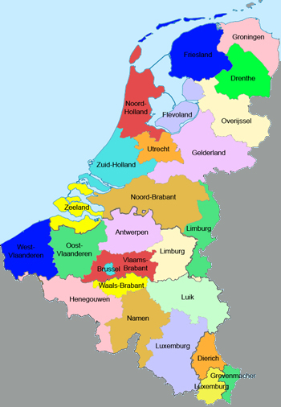
1.2 The Benelux
1
Netherlands:
- population: 16,686,000
- language: mostly dutch
- GDP (nominal): $40,764 (per capita)
Belgium:
- population: 11,007,020
- language: dutch, french, german
- GDP (nominal): $42,630 (per capita)
Luxembourg:
- population: 511,840
- language: luxembourgish, german, french
- GDP (nominal): $81,383 (per capita)

Slide 7
Agenda
1. Tasks
2. Netherlands
3. Belgium
4. Luxembourg

Slide 8
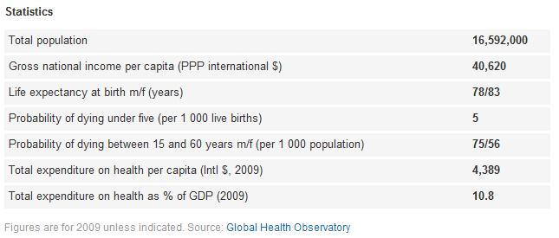
2.1 Facts Netherlands (1/2)
2
Source: WHO

Slide 9
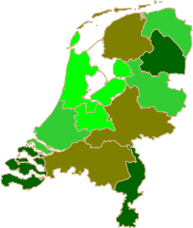
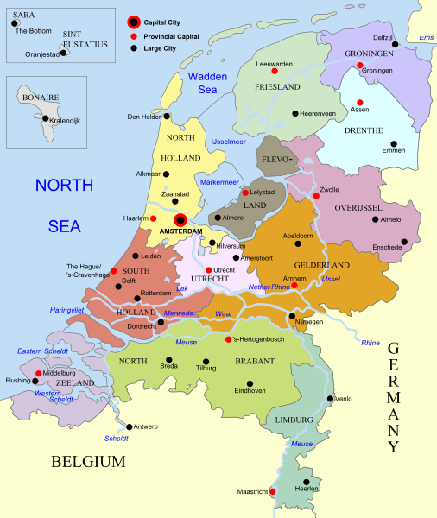

2.1 Facts Netherlands (2/2)
2
Federal States of the Netherlands
Percentage of Seniors of
the total population

Slide 10
2.2 Overview Healt Care System (1/4)
2
Representive Organizations
Public
Ministry of Health, Welfare, and Sport
Center for Needs Assessment (CIZ)
Dutch Health Care Authority (Nza)
NIGZ (Netherland Institute for Health Promotion)
Long-term (home care, residential and nursing home care): AWBZ (Exceptional Medical Expenses Act)
UNO (University Network of Organizations for elderly Care)
Supervise the three health care markets (provision, insurance, purchasing)
Assesses patients` situations and decides what care is required
NIVEL
Short-term (primary care, acute care…): Health Insurance Act/Health Care Allowance Act*
RIVM
SOON
Health Care Institutions Administration Act*
NeVeP

Slide 11
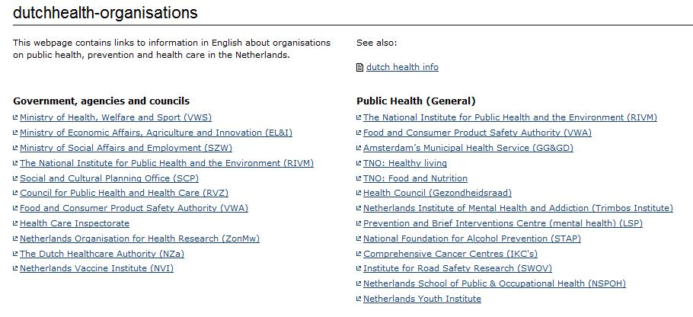
2.2 Overview Healt Care System (2/4)
2
Representive Organizations
Public

Slide 12
2.2 Overview Healt Care System (3/4)
2
Representive Organizations
Public
Ministry of Health, Welfare, and Sport
Center for Needs Assessment (CIZ)
Dutch Health Care Authority (Nza)
NIGZ (Netherland Institute for Health Promotion)
Long-term (home care, residential and nursing home care): AWBZ (Exceptional Medical Expenses Act)
UNO (University Network of Organizations for elderly Care)
Supervise the three health care markets (provision, insurance, purchasing)
Assesses patients` situations and decides what care is required
NIVEL
Short-term (primary care, acute care…): Health Insurance Act/Health Care Allowance Act*
RIVM
SOON
Health Care Institutions Administration Act*
NeVeP

Slide 13
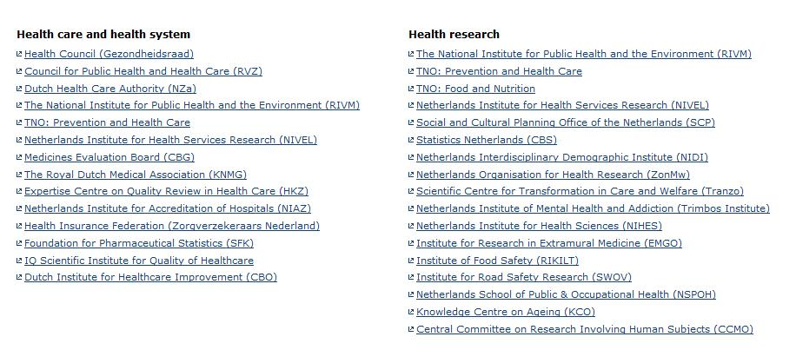
2.2 Overview Healt Care System (4/4)
2
Representive Organizations
Public

Slide 14
2.3 Remarks
2
8% of older people are in residential or nursing home
Representive Organizations are funded by AWBZ + individual fee for each
person based on income, age, household situation
Easy access to geriatric medical care
Waiting lists for admission to residential
homes, nursing homes and home care
* For more information see PDF „Dutch Healt Care Performance“

Slide 15
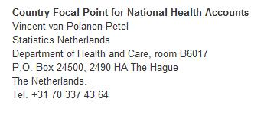
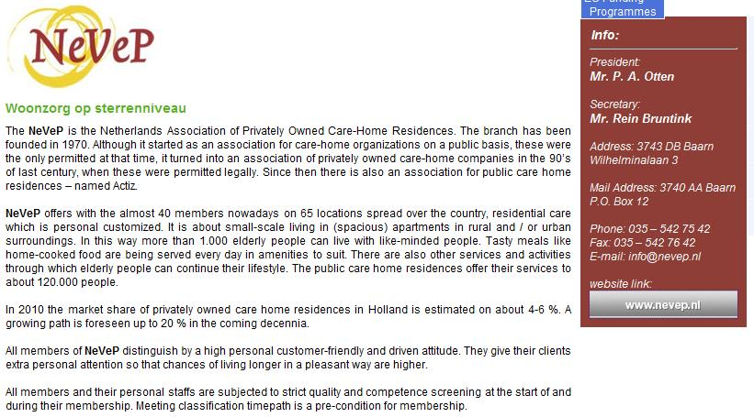
2.4 Contacts (1/4)
2

Slide 16
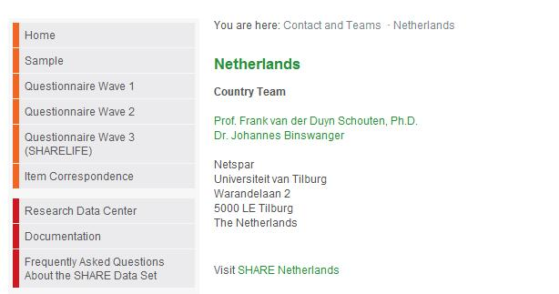
2.4 Contacts (2/4)
2

Slide 17
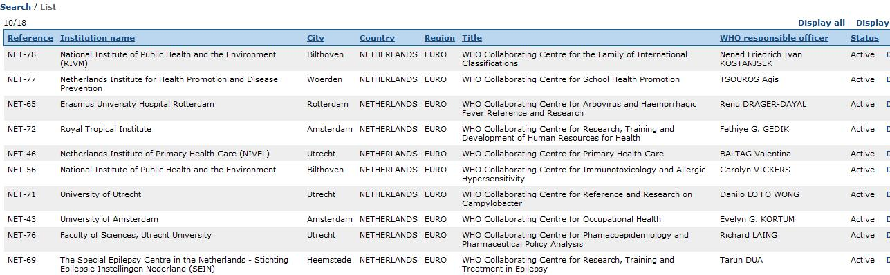
2.4 Contacts (3/4)
2

Slide 18
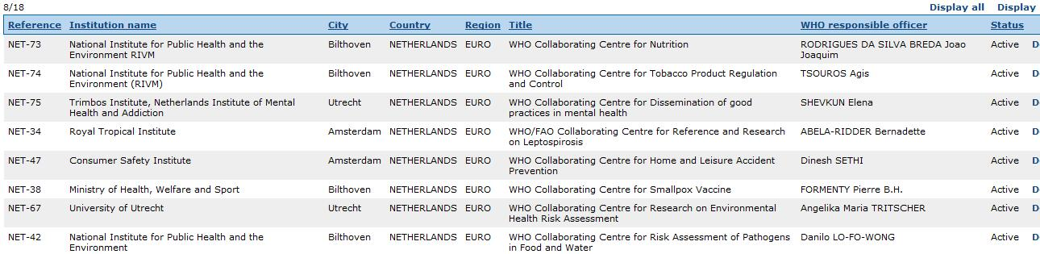
2.4 Contacts (4/4)
2

Slide 19
Agenda
1. Tasks
2. Netherlands
3. Belgium
4. Luxembourg

Slide 20
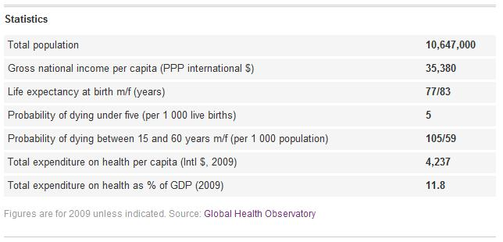
3.1 Facts Belgium
3
Source: WHO

Slide 21
3.2 Overview Health Care System (1/2)
3
Public
Representive Organi-zations/Initiatives
KCE (Belgian Health Care Knowledge Center
National Institute for Sickness and Disability Insurance *
Community Ministries of Health (Dutch,-French,-German-speaking
NARIC (National Academic Recognition Information Center)
Eurodiaconia
Flemish Community: SITs (Cooperation Initiatives in Home Care)
Federal Public Service of Health, Food Chain Safety and Environment
Federal Public Service Social Security
French Community: CSSDS (Coordina-tion Centres for Home Care and Services)
Integrated Service for Home Care (GDT – SISD)**

Slide 22
3.2 Overview Health Care System (2/2)
3
Public
Representive Organi-zations/Initiatives
KCE (Belgian Health Care Knowledge Center
National Institute for Sickness and Disability Insurance *
Community Ministries of Health (Dutch,-French,-German-speaking
NARIC (National Academic Recognition Information Center)
Eurodiaconia
Flemish Community: SITs (Cooperation Initiatives in Home Care)
Federal Public Service of Health, Food Chain Safety and Environment
Federal Public Service Social Security
French Community: CSSDS (Coordina-tion Centres for Home Care and Services)
Integrated Service for Home Care (GDT – SISD)**

Slide 23
3.3 Remarks
3
health care system publicly funded and mainly privately provided
regional government responsible für aspects of elderly care
four major health services: home care center for day care, residential
homes, rest homes, nursing homes
* responsible for general organization of the health care system, transferring funds to the not-
for-profit and privately managed sickness funds
** coordinate all disciplines involved in home care in a defined geographic area

Slide 24
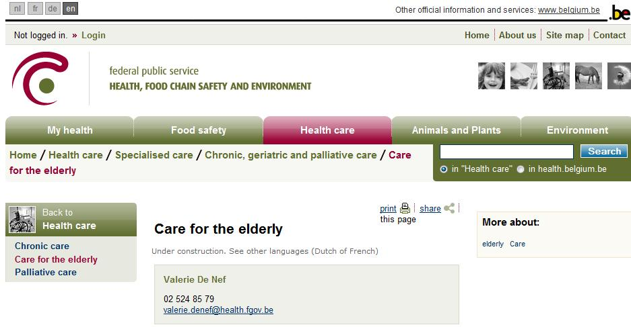
3.4 Contacts (1/5)
3

Slide 25
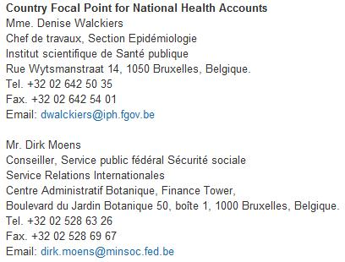
3.4 Contacts (2/5)
3

Slide 26
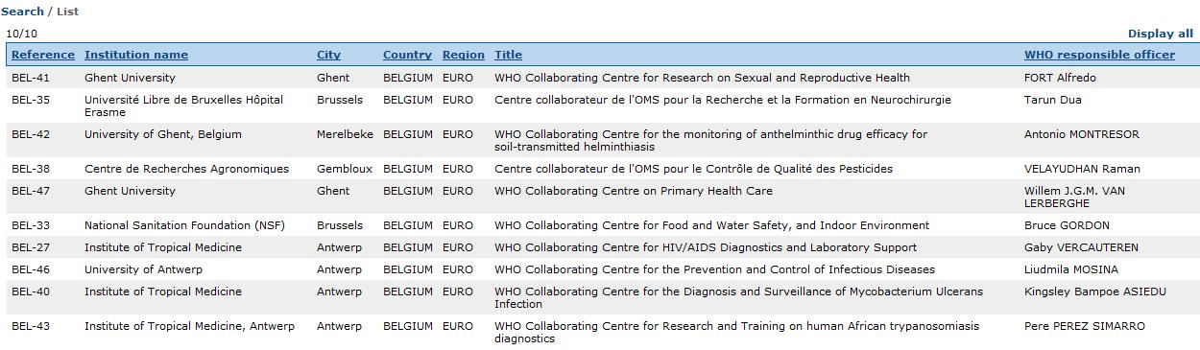
3.4 Contacts (3/5)
3

Slide 27
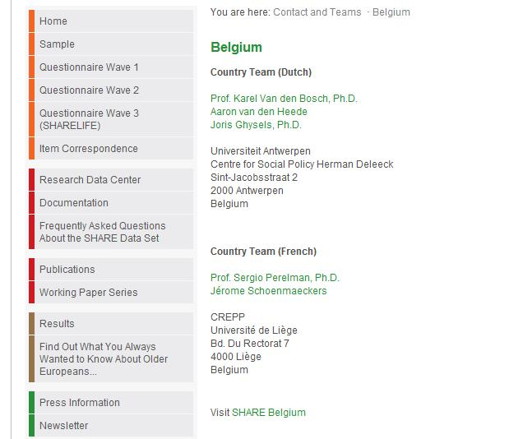
3.4 Contacts (4/5)
3

Slide 28

3.4 Contacts (5/5)
3

Slide 29
Agenda
1. Tasks
2. Netherlands
3. Belgium
4. Luxembourg

Slide 30
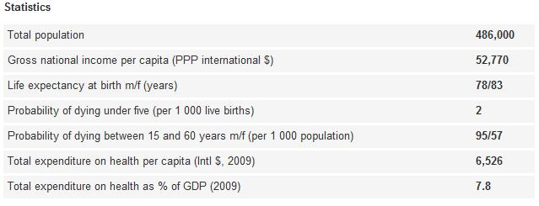
4. 1 Facts Luxembourg
4
Source: WHO

Slide 31
4. 2 Overview Health Care System (1/2)
4
Representive Organizations
Public
RBS socio-family service
Luxembourgish Alzheimer Association
(ALA)
Ministry of Family Affairs
Health Ministry
OMEGA 90 (Association for Training in Palliative Care)
Financier New Projects
Long-Term Care Insurance
ALGG (Luxembourg Gerontology/Geriatric Association)
Direct Support and Care of Older Citizens
Health Insurance
COPAS (Luxembourg Confederation of Service Providers and Associations of Prevention)
See PDFs „Eurofamcare“, „HealthCareServices“
EGIPA (Association of Managers of Old Peoples`Home Institutions)

Slide 32
4. 2 Overview Health Care System (2/2)
4
Representive Organizations
Public
RBS socio-family service
Luxembourgish Alzheimer Association
(ALA)
Ministry of Family Affairs
Health Ministry
OMEGA 90 (Association for Training in Palliative Care)
Financier New Projects
Long-Term Care Insurance
ALGG (Luxembourg Gerontology/Geriatric Association)
Direct Support and Care of Older Citizens
Health Insurance
COPAS (Luxembourg Confederation of Service Providers and Associations of Prevention)
See PDFs „Eurofamcare“, „HealthCareServices“
EGIPA (Association of Managers of Old Peoples`Home Institutions)

Slide 33
4.3 Remarks
Master Programme in Gerontology at the University of Luxembourg
Health Care System is quite similar to the one in Germany
RBS Center is planning and conducting a big country study about elder
care in Luxembourg
further contact details (as in 4.4) are available in the relevant links
only a few studies about Luxembourg, because of the relative small
population
4

Slide 34
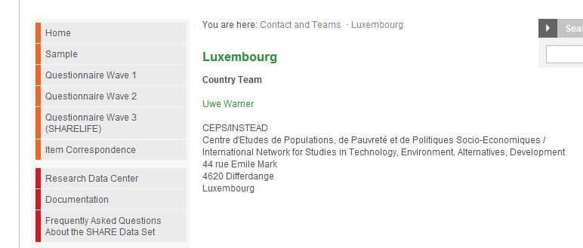
4.4 Contacts (1/2)
4

Slide 35
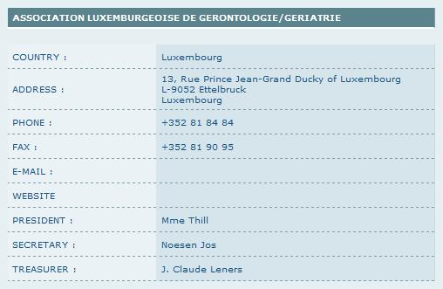
4.4 Contacts (2/2)
4

Slide 36
Issued by
Sebastian Eckert
Friedrich-Ebert-Strasse 172
48153 Münster
Germany
+4915208726837
s_ecke05@uni-muenster.de
sebastian_eckert87 (skype)

